Slide 1

CocaCola Stock Forecasting
By Moshe Burnstein

Slide 2


Agenda
Business Problem
Background/History
Models
Analysis
Recommendations
Ethical Issues
References
ThePhoto by PhotoAuthor is licensed under CCYYSA.

Slide 3
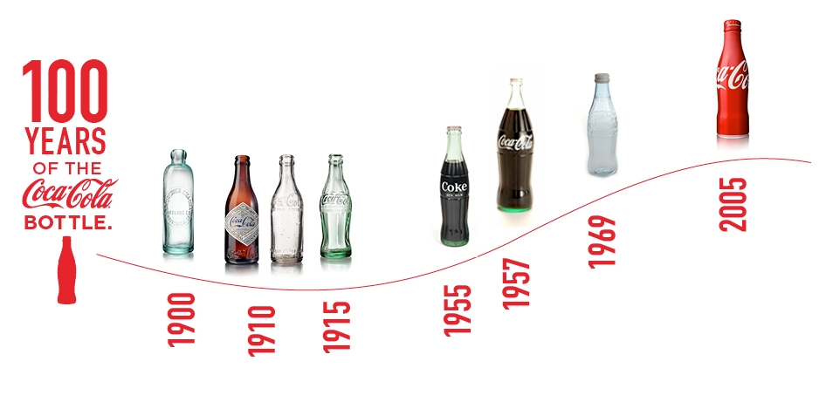
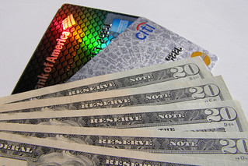
Business Problem
Cash from Credit Card vs
Investing in KO
ThePhoto by PhotoAuthor is licensed under CCYYSA.
CocaCola Stock Forecasting
3
ThePhoto by PhotoAuthor is licensed under CCYYSA.

Slide 4
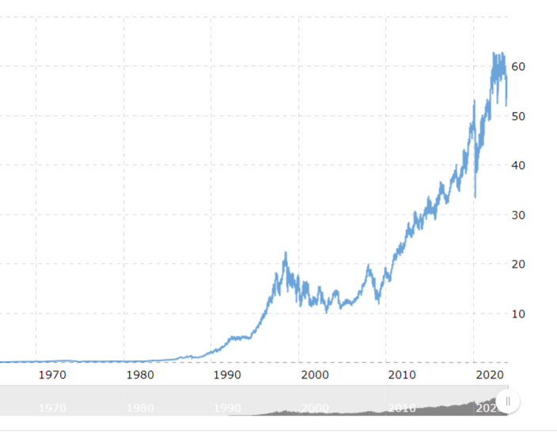
Background/History
Annual revenue growth

Slide 5
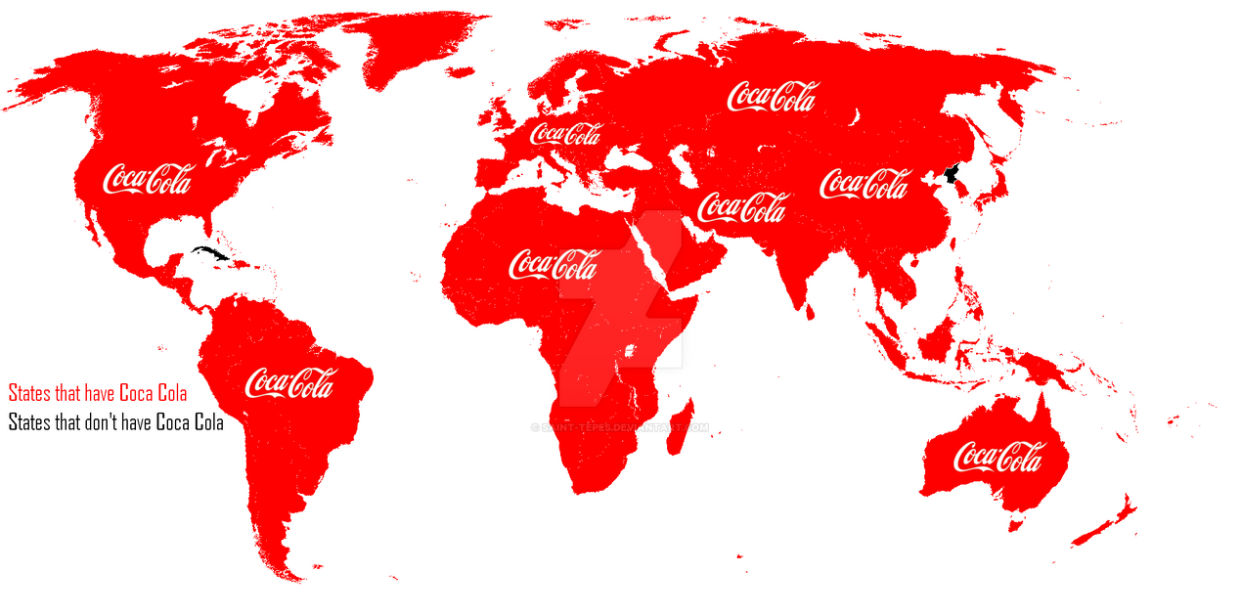

Dividends
Market Share​

Slide 6
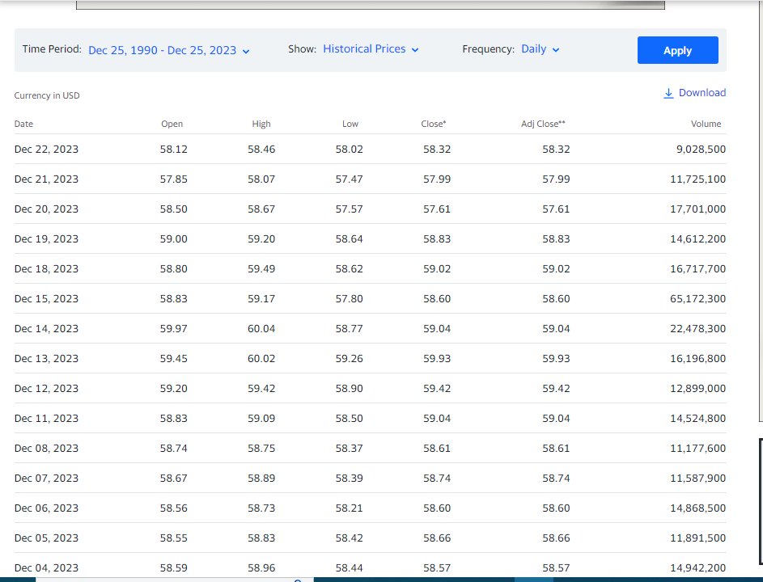
Data

Slide 7

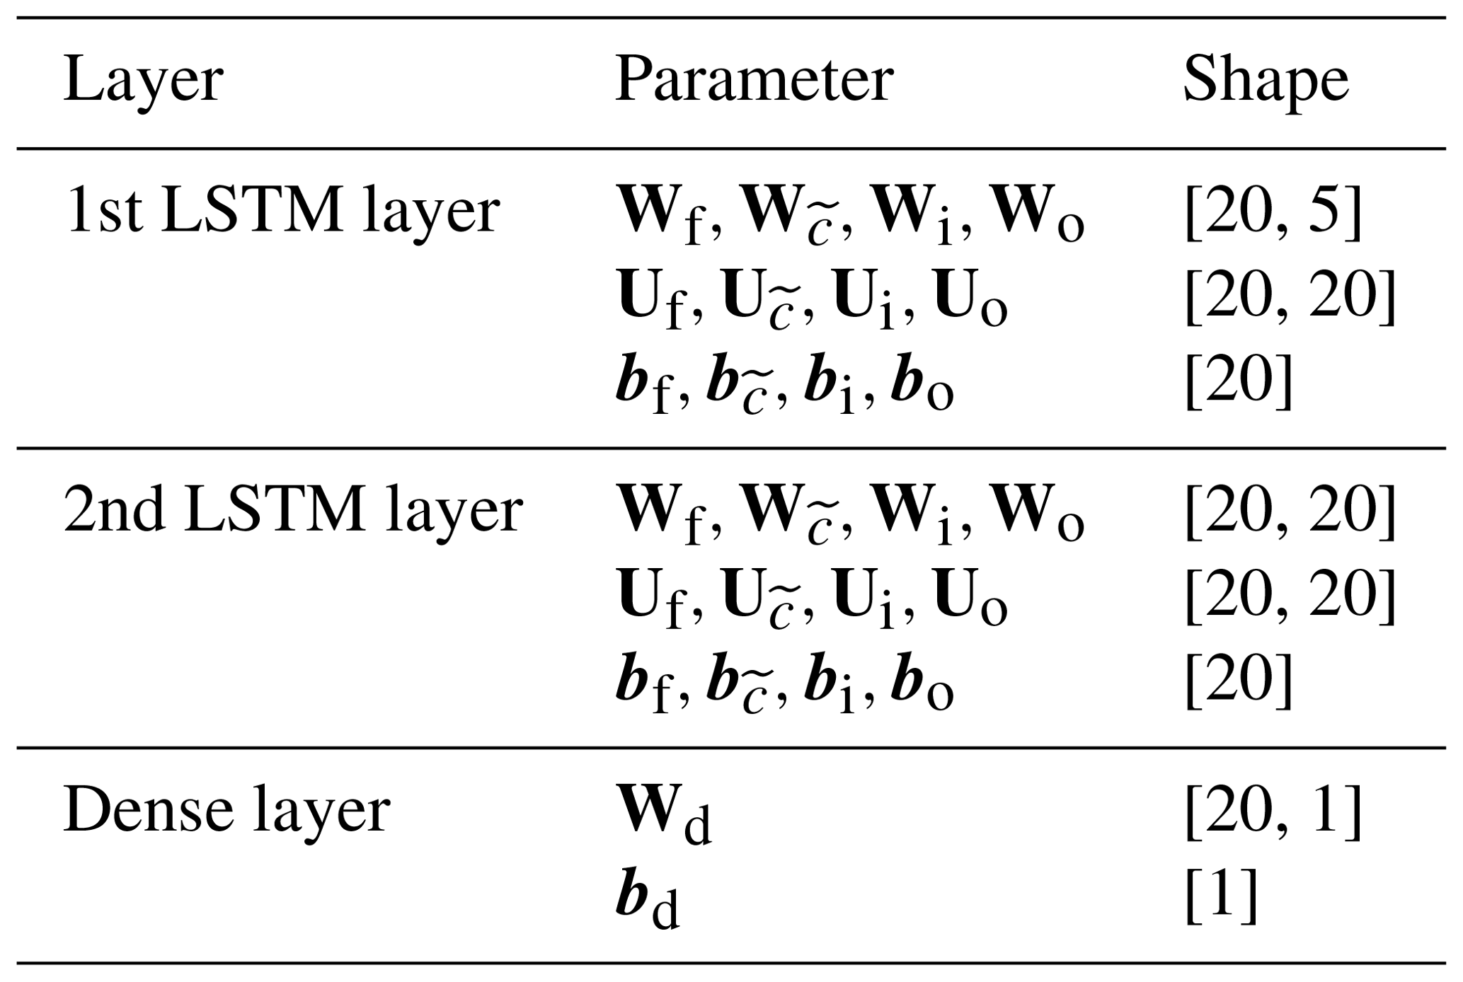
FB Prophet LSTM
ThePhoto by PhotoAuthor is licCocaCola Stock Forecasting
ensed under CCYYSA.

Slide 8
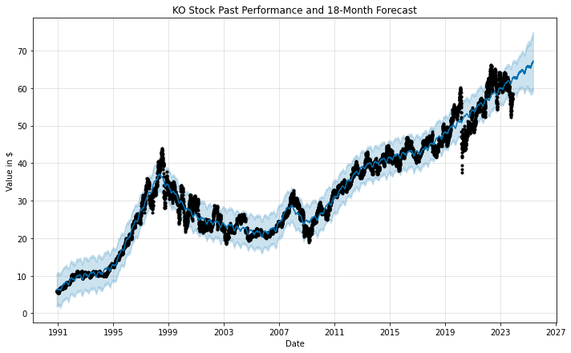
Prophet

Slide 9
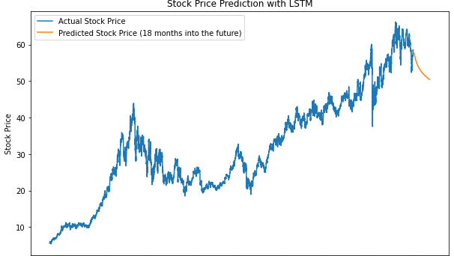
LSTM

Slide 10
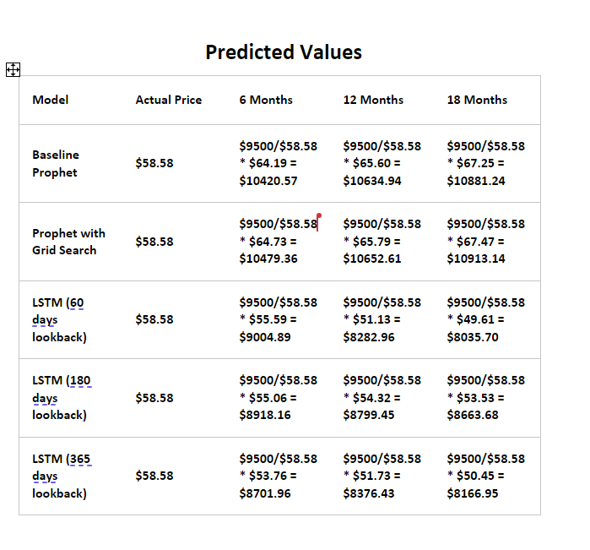

Slide 11
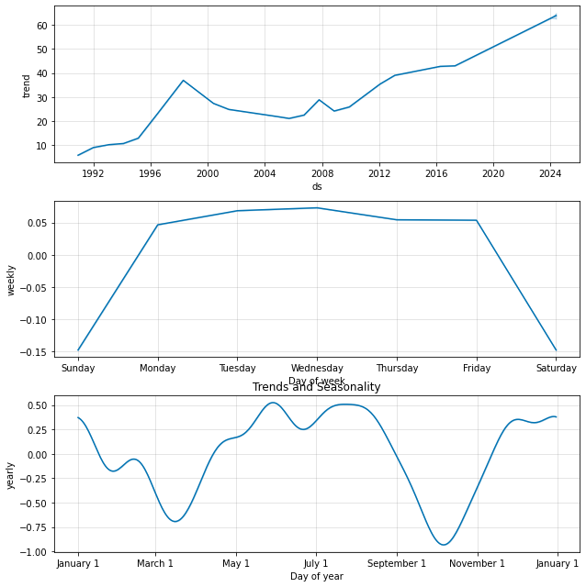
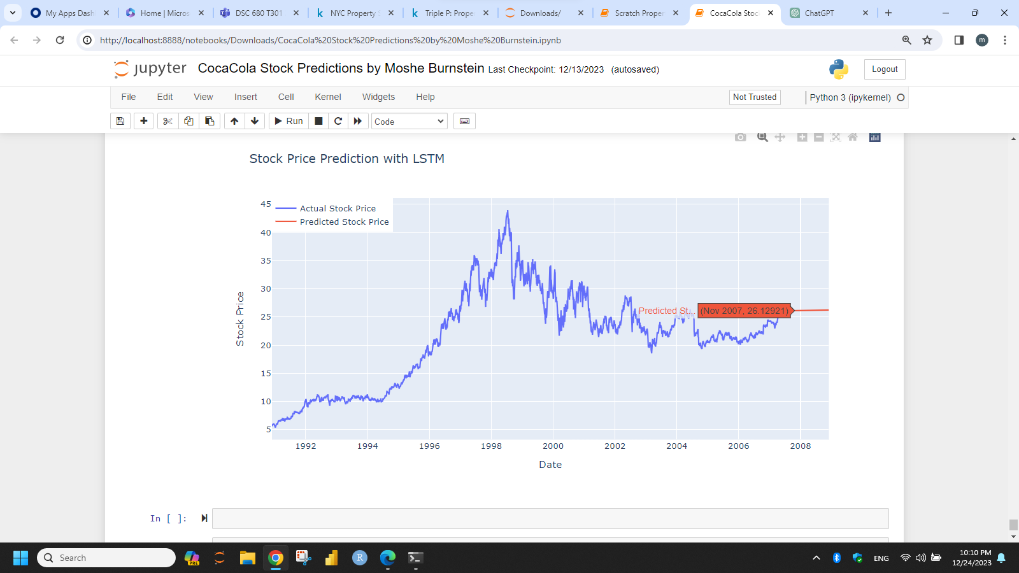
Compare LSTM Predictions to Actual Prices

Slide 12
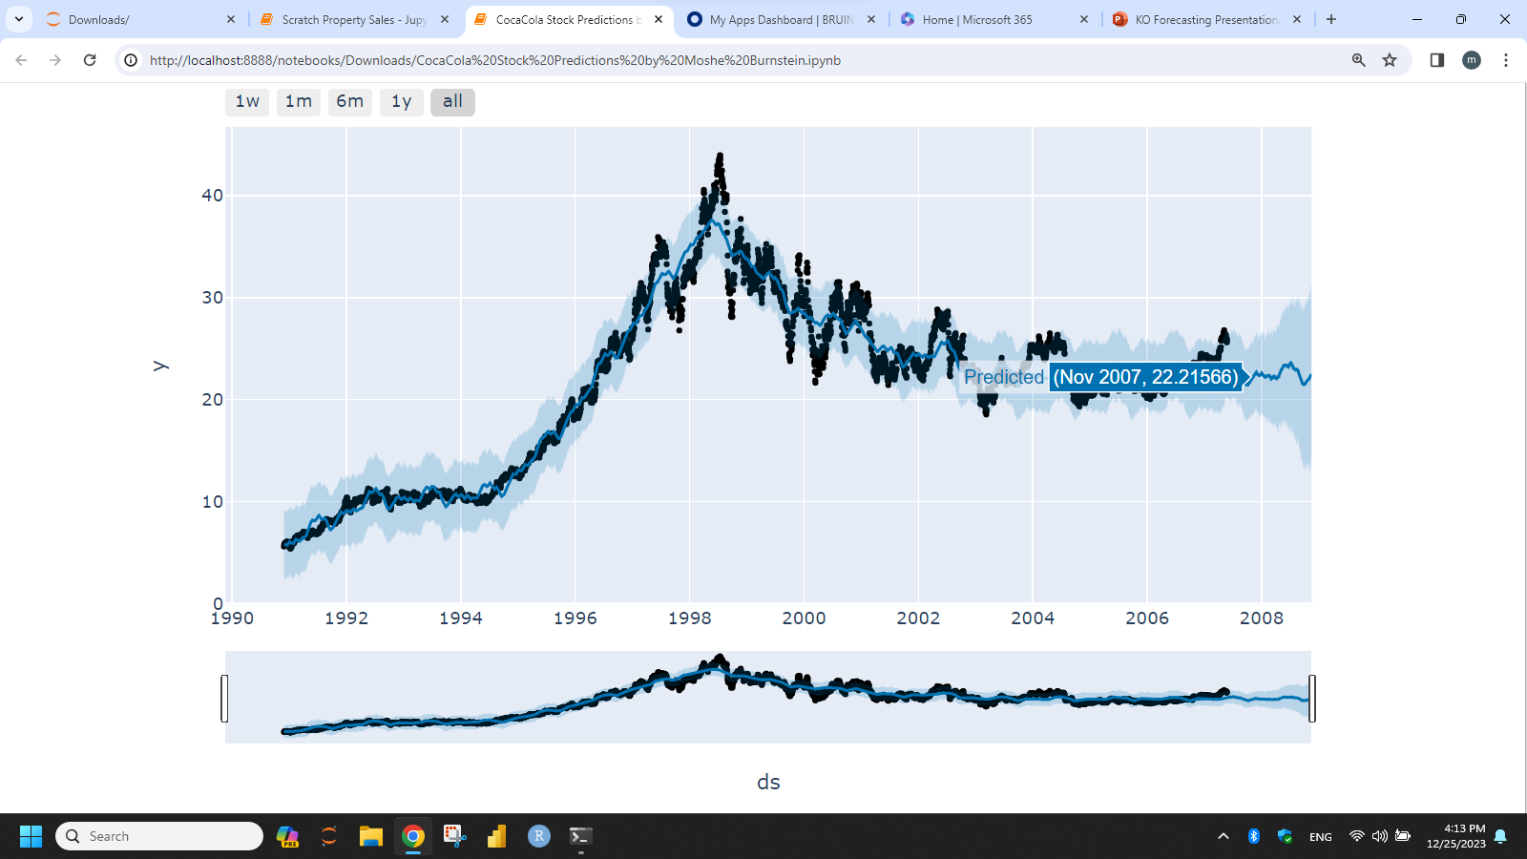
Prophet Predictions on First Half of Data

Slide 13
Recommendations
Go with Prophet Model with Grid Search
If you have the stomach for it...invest
Decide price at which you must sell, for better or for worse
Explore using such modeling for other stocks
Incorporate this type of modeling into comprehensive financial advisory plan

Slide 14
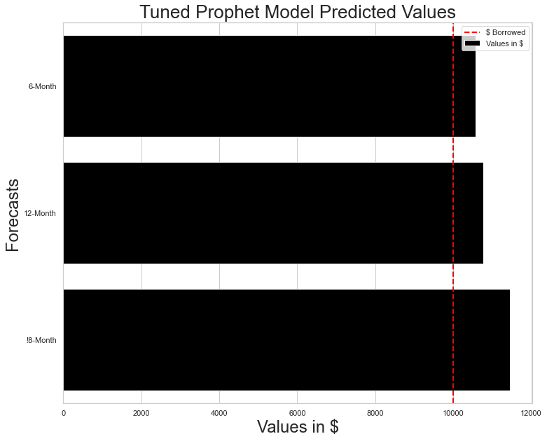
What Your $10,000 Loan Will Earn

Slide 15

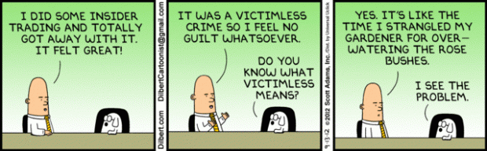

Ethical Issues
ThePhoto by PhotoAuthor is licensed under CCYYSA.
ThePhoto by PhotoAuthor is licensed under CCYYSA.
Transparency to stakeholder about risks of investing
Advise risk mitigation options
Inform of ominous signs of recession
Ensure data team members disclose all stock holdings

Slide 16
References
Cocacola - 61 year stock price history: KO. Macrotrends. (n.d.). https://www.macrotrends.net/stocks/charts/KO/cocacola/stock-price-history
Historical data. The Coca-Cola Company. (n.d.). https://investors.coca-colacompany.com/stock-information/historical-data
Ferri, R. (2023, September 12). Any monkey can beat the market. Forbes. https://www.forbes.com/sites/rickferri/2012/12/20/any-monkey-can-beat-the-market/?sh=7e5e33ab630a
Forecasting at scale. Prophet. (n.d.). https://facebook.github.io/prophet/
History of Coca-Cola. IG. (n.d.). https://www.ig.com/en-ch/shares/markets-shares/coca-cola-co-KO-US/history-of-coca-cola
Kenton, W. (n.d.). What is the GARCH process? how it’s used in different forms. Investopedia. https://www.investopedia.com/terms/g/generalalizedautogregressiveconditionalheteroskedasticity.asp
Market activity market activity -> stocks options etfs mutual funds indexes commodities cryptocurrency currencies futures fixed income global markets market regulation -> U.S. regulation European regulation quick links real-time quotes after-hours quotes pre-market quotes NASDAQ-100 symbol Screener Online Brokers Glossary Sustainable Bond Network Symbol Change History IPO Performance Ownership Search Dividend History investing lists Fundinsight market events economic calendar earnings IPO calendar dividend calendar spo calendar holiday schedule analyst activity analyst recommendations daily earnings surprise forecast changes commodities -> gold copper crude oil natural gas Nasdaq Data Statistical Milestones Total returns daily market statistics most active see all market activity ->. Nasdaq. (n.d.). https://www.nasdaq.com/market-activity/stocks/ko/historical
Mitchell, A. C. (2023, December 3). Best and worst months for the stock market - seasonal patterns. Trade That Swing. https://tradethatswing.com/seasonal-patterns-of-the-stock-market/
Robbins, N., & The Motley Fool Founded in 1993 in Alexandria. (n.d.). A bull market could be here: 3 reasons to buy Coca-Cola Stock. Nasdaq. https://www.nasdaq.com/articles/a-bull-market-could-be-here:-3-reasons-to-buy-coca-cola-stock-0
Sor, J. (n.d.). The stock market could plunge as much as 27% when the economy finally tips into recession, investment research firm says. Business Insider. https://www.businessinsider.com/stock-market-crash-sp500-prediction-recession-2024-us-economy-outlook-2023-11
Team, T. I. (n.d.). Why did Warren Buffett invest heavily in Coca-Cola (KO) in the late 1980s? Investopedia. https://www.investopedia.com/ask/answers/052615/why-did-warren-buffett-invest-heavily-cocacola-ko-late-1980s.asp
Understanding LSTM networks. Understanding LSTM Networks -- colah’s blog. (n.d.). https://colah.github.io/posts/2015-08-Understanding-LSTMs/
Watrous, M. (2023, October 26). Coca-Cola “very focused on” impact of weight loss drugs. Food Business News. https://www.foodbusinessnews.net/articles/24903-coca-cola-very-focused-on-impact-of-weight-loss-drugs
Yahoo! (2023, December 6). The Coca-Cola Company (KO) stock historical prices & data. Yahoo! Finance. https://finance.yahoo.com/quote/KO/history?period1=657849600&period2=1701820800&interval=1mo&filter=history&frequency=1mo&includeAdjustedClose=true

Slide 17
Thank you
Moshe Burnstein
https://github.com/mosheburnstein0/BurnsteinPortfolio/tree/main
https://manage.wix.com/dashboard/9ce5879c-c0d4-4121-851a-09f5f50408a9/portfolio/projects

